Slide 1
Air Quality Index Analysis
AIR QUALITY INDEX ANALYSIS AIM :- To provide a numerical value representative of overall air quality, essential for public health and environmental management.

Slide 2
Below are the steps we can follow for the task of Air Quality Index Analysis:
Gather air quality data from various sources, such as government monitoring stations, sensors, or satellite imagery.
Clean and preprocess the collected data.
Calculate the Air Quality Index using standardized formulas and guidelines provided by environmental agencies.
Create visualizations, such as line charts or heatmaps, to represent the AQI over time or across geographical regions.
Compare the AQI metrics of the location with the recommended air quality metrics.
So, the process starts with collecting air quality data. I found an ideal dataset for this task based on the air quality of Delhi in January 2023.

Slide 3
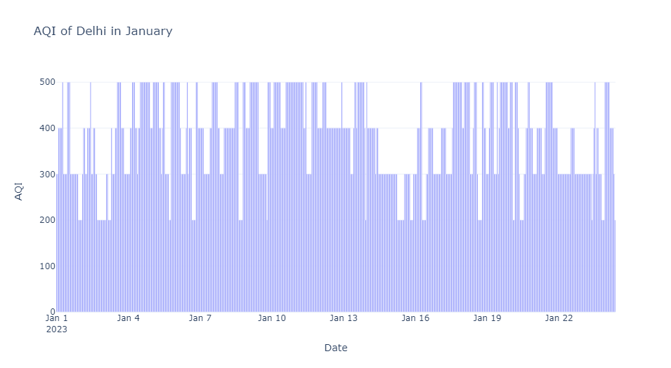
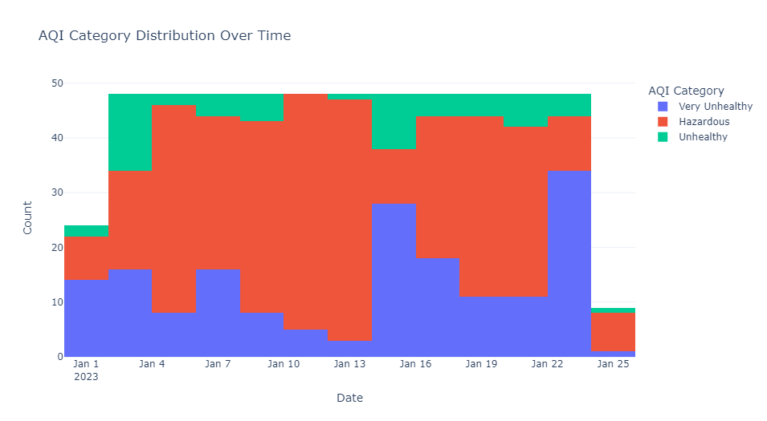

Slide 4
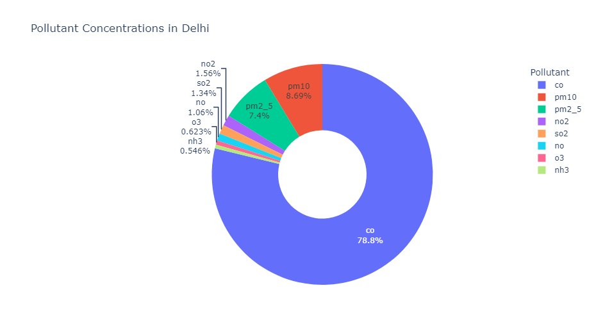
THE DISTRIBUTION OF POLLUTANTS IN THE AIR QUALITY OF DELHI

Slide 5
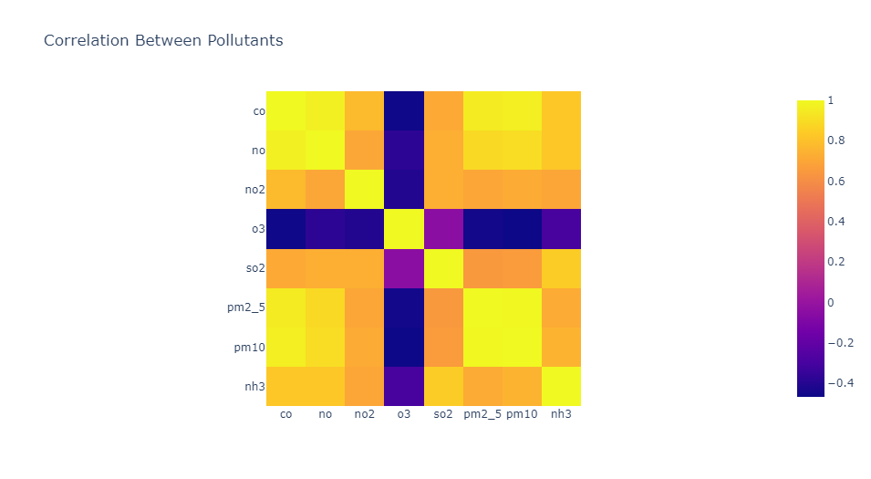
The correlation matrix displayed here represents the correlation coefficients between different air pollutants in the dataset. Correlation coefficients measure the strength and direction of the linear relationship between two variables, with values ranging from -1 to 1. Overall, the positive correlations among CO, NO, NO2, SO2, PM2.5, PM10, and NH3 suggest that they may share common sources or have similar pollution patterns, while O3 exhibits an inverse relationship with the other pollutants, which may be due to its role as both a pollutant and a natural atmospheric oxidant.

Slide 6
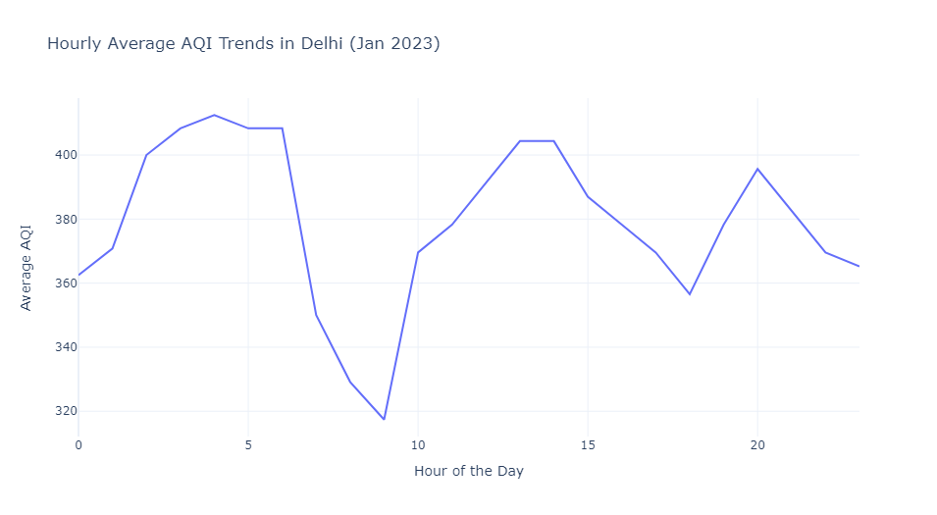
let’s have a look at the average AQI by day of the week in Delhi:

Slide 7
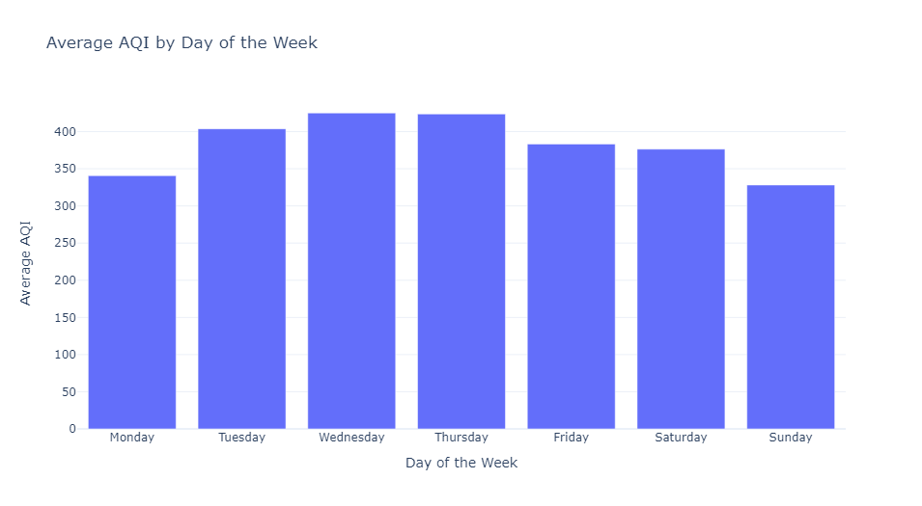
It shows that the air quality in Delhi is worse on Wednesdays and Thursdays. So, this is how you can analyze the air quality index of a specific location

Slide 8
